Slide 1

Intern Project Presentation
On
Caffe & Deep Compression
By
Satish.G
(Mentor:Vishal Vaddina)

Slide 2
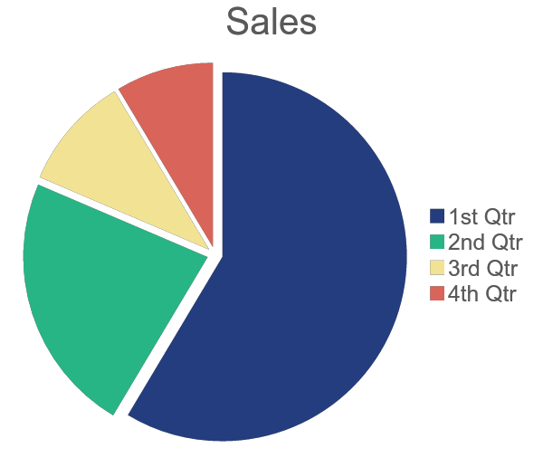
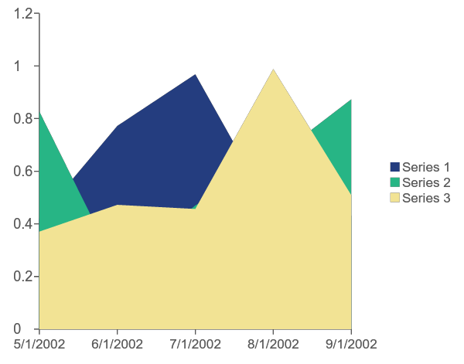
Some more chart examples
Agenda
Caffe
Demo
Deep
Compression
D
Demo
Introduction
Introduction
Implementation
on a TensorFlow model
Code
walkthrough
‹#›

Slide 3
PROJECT: Caffe
OBJECTIVE:
Caffe is a deep learning framework which is written in C++, with a Python interface. With the increase in popularity of this framework in recent days, I was required to research & explore Caffe and document the experience, issues, comparisons etc.

Slide 4
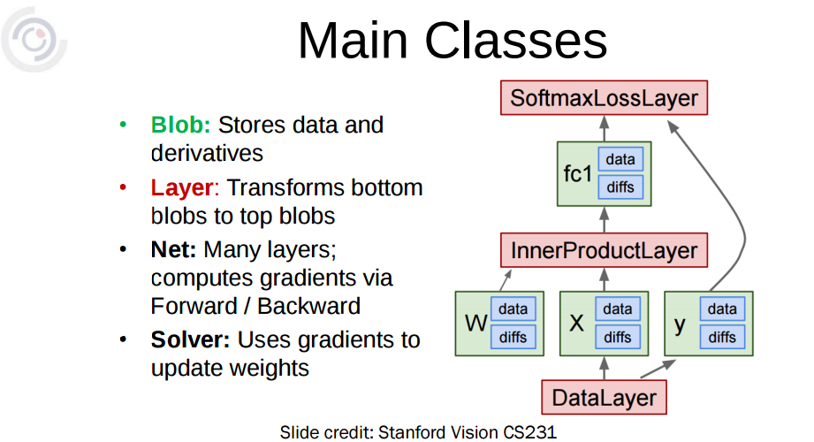
Introduction:

Slide 5
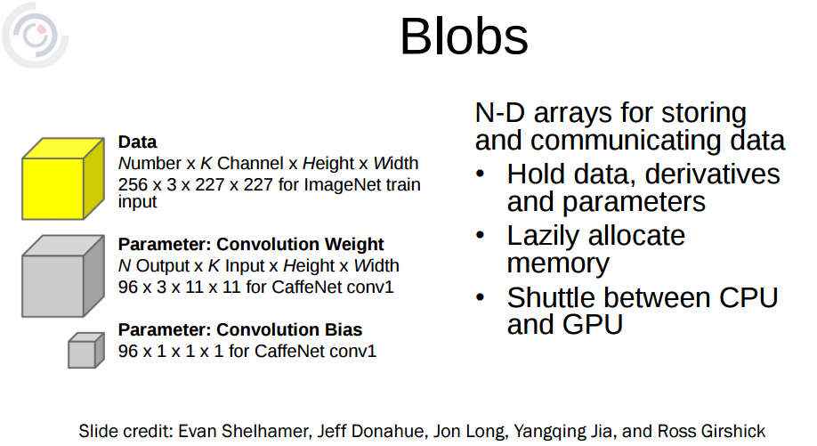

Slide 6
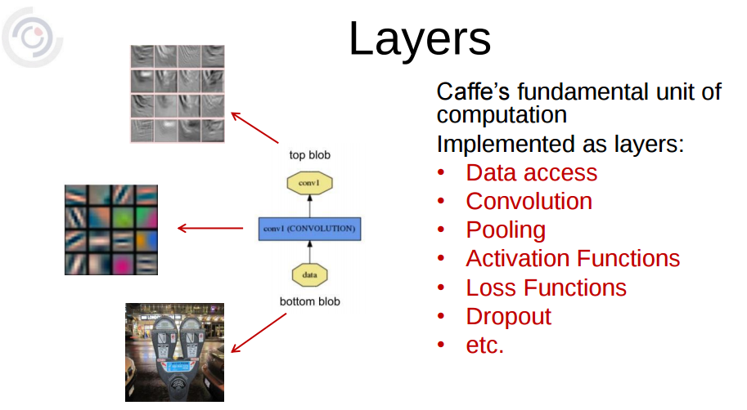

Slide 7
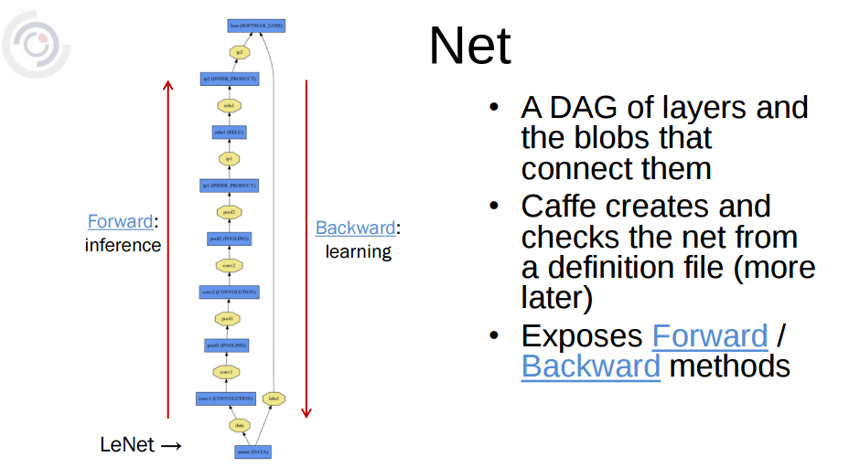

Slide 8
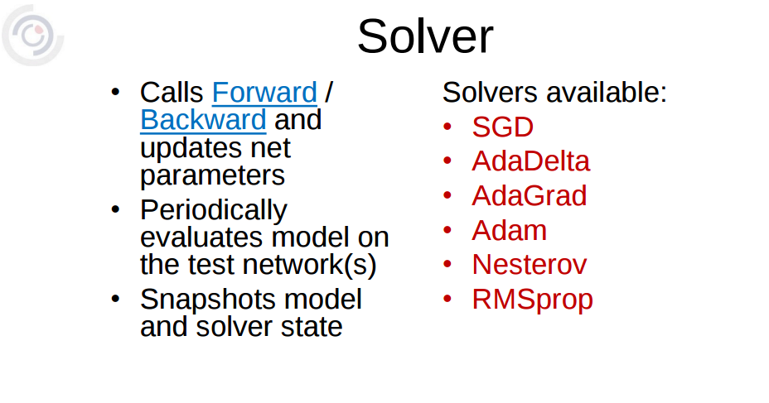

Slide 9
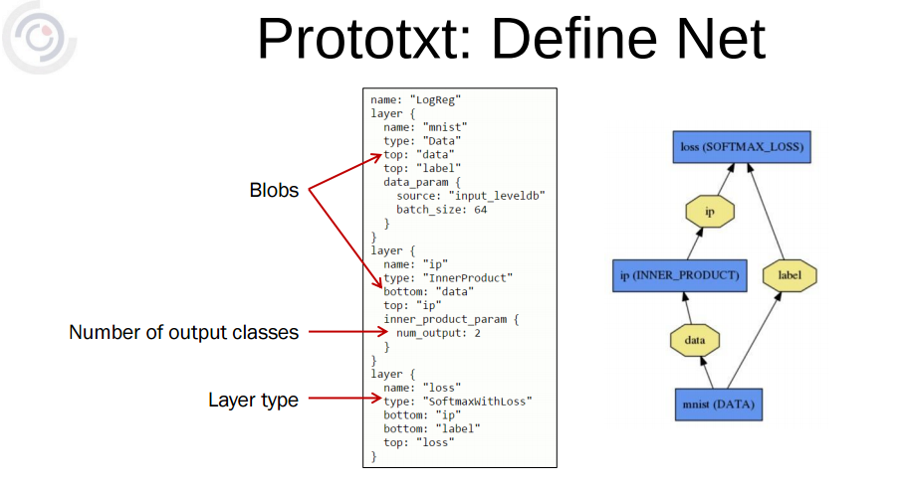

Slide 10
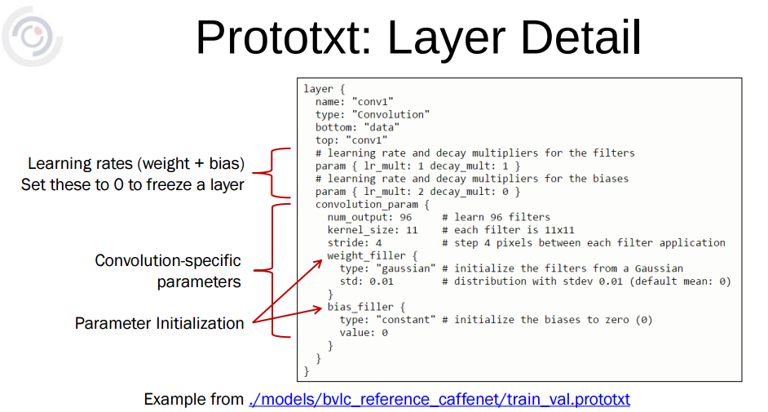
There will be one more layer detail prototxt,
deploy.prototxt:
Used for testing.This will be same as training except without loss layer and few modifications in input layer

Slide 11
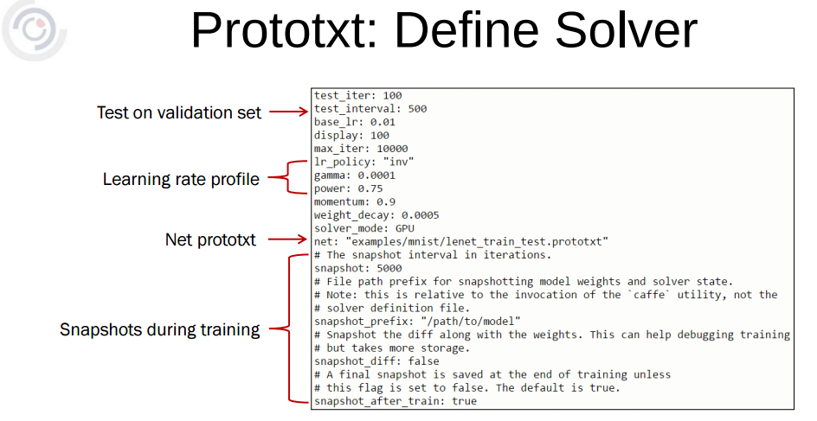

Slide 12


Slide 13
Strengths | Weakness
Easy to understand Easy to compile,finetune,use predefined models Don’t need to worry about coding Viable for Research Fastest library on CPU Good python and MATLAB interfaces A big benefit of the library is the no.of pretrained models that can be downloaded. | Main focus on CNN No proper documentation on RNN models Need to define layers completely No modularity(can’t define functions) Lack of extensive wrappers, leading to redundancy(Makes code cumbersome)
Caffe is your goto ML library:
If you are curious about deep learning and interested in modeling CNNs or solve your image processing problems.

Slide 14


Slide 15
PROJECT: Deep Compression
OBJECTIVE:
Deep learning models generally include deep networks, having a large number of neurons and connections and hence, generally very large in size.
This makes these models very difficult to be deployed in small devices like mobiles, smart watches etc. Hence,Deep-Compression comes into play.
With recent developments, this process with certain compressing tasks in pipeline results in a reduction of the model size by about 35-50 times, making it very easy for deploying in small devices and faster computations.
Implement the Deep Compression pipeline procedure involving Pruning, Quantization and Huffman Coding.

Slide 16


Slide 17
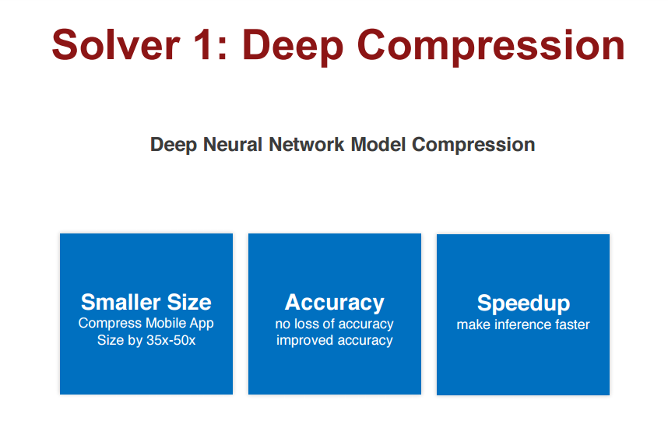

Slide 18
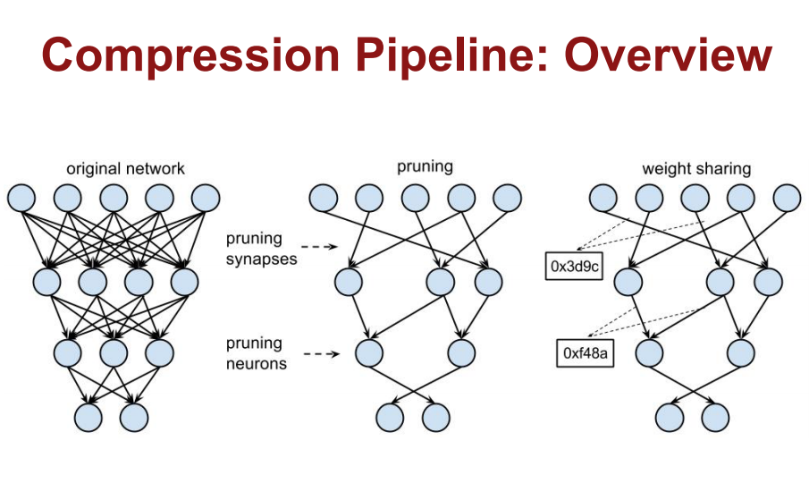

Slide 19
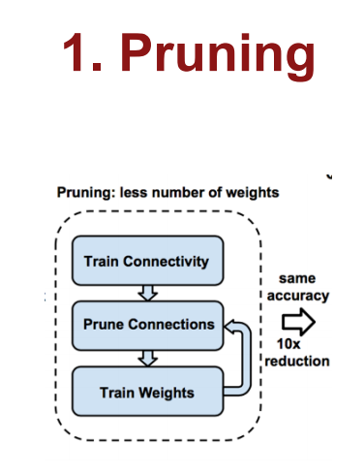
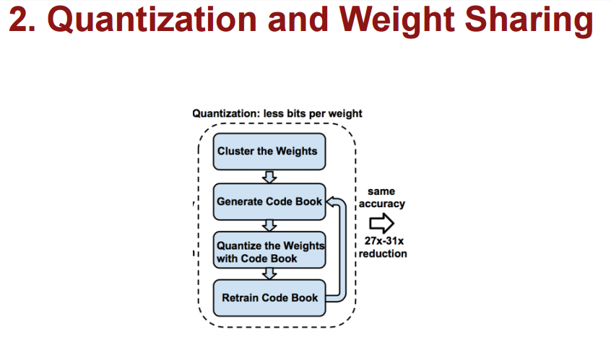

Slide 20
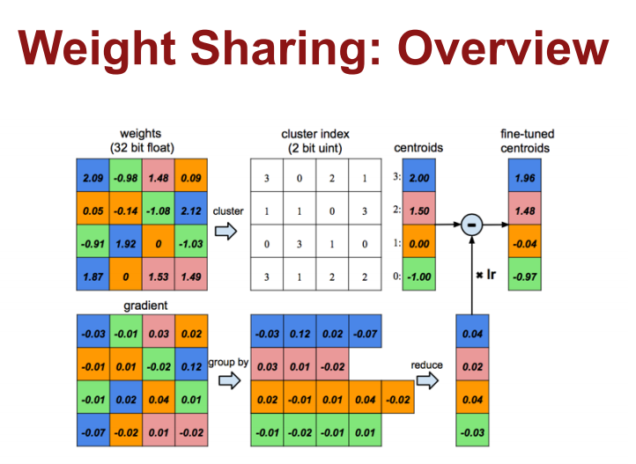
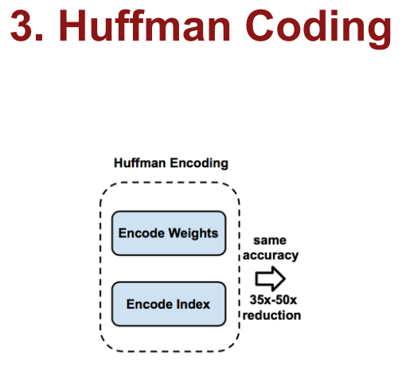

Slide 21
Hurdles:
It is not open sourced
No documentation on implementation
Time: Unable to work on Huffman encoding
Implementation:
Implemented pruning on a TensorFlow following a github implementation
TensorFlow Quantization is used

Slide 23



Slide 24
We solved it by using
Deep Compression and reduced the download bandwidth.

